Slide 1



Slide 2



Slide 3
CONTROLLING SIZES OF
IMAGES USING CSS
img.large {
width: 500px;
height: 500px;}
img.medium {
width: 250px;
height: 250px;}
img.small {
width: 100px;
height: 100px;}

Slide 4
CONTROLLING SIZES OF
IMAGES USING CSS
img.large {
width: 500px;
height: 500px;}
img.medium {
width: 250px;
height: 250px;}
img.small {
width: 100px;
height: 100px;}

Slide 5
CONTROLLING SIZES OF
IMAGES USING CSS
img.large {
width: 500px;
height: 500px;}
img.medium {
width: 250px;
height: 250px;}
img.small {
width: 100px;
height: 100px;}

Slide 6
CONTROLLING SIZES OF
IMAGES USING CSS
img.large {
width: 500px;
height: 500px;}
img.medium {
width: 250px;
height: 250px;}
img.small {
width: 100px;
height: 100px;}

Slide 7
CONTROLLING SIZES OF
IMAGES USING CSS
img.large {
width: 500px;
height: 500px;}
img.medium {
width: 250px;
height: 250px;}
img.small {
width: 100px;
height: 100px;}

Slide 8
CONTROLLING SIZES OF
IMAGES USING CSS
img.large {
width: 500px;
height: 500px;}
img.medium {
width: 250px;
height: 250px;}
img.small {
width: 100px;
height: 100px;}

Slide 9
CONTROLLING SIZES OF
IMAGES USING CSS
img.large {
width: 500px;
height: 500px;}
img.medium {
width: 250px;
height: 250px;}
img.small {
width: 100px;
height: 100px;}

Slide 10
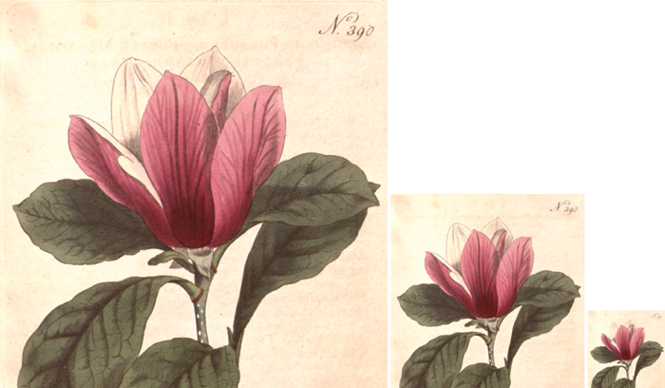

Slide 11
ALIGNING IMAGES
USING CSS
img.align: left {
float: left;
margin-right: 10px;}
img.align-right {
float: right;
margin-left: 10px;}
Notes:
Note: It's important to create a gap between text and pictures.

Slide 12
ALIGNING IMAGES
USING CSS
img.align: left {
float: left;
margin-right: 10px;}
img.align-right {
float: right;
margin-left: 10px;}

Slide 13
ALIGNING IMAGES
USING CSS
img.align: left {
float: left;
margin-right: 10px;}
img.align-right {
float: right;
margin-left: 10px;}

Slide 14
ALIGNING IMAGES
USING CSS
img.align: left {
float: left;
margin-right: 10px;}
img.align-right {
float: right;
margin-left: 10px;}

Slide 15
ALIGNING IMAGES
USING CSS
img.align: left {
float: left;
margin-right: 10px;}
img.align-right {
float: right;
margin-left: 10px;}

Slide 16
ALIGNING IMAGES
USING CSS
img.align: left {
float: left;
margin-right: 10px;}
img.align-right {
float: right;
margin-left: 10px;}

Slide 17
ALIGNING IMAGES
USING CSS
img.align: left {
float: left;
margin-right: 10px;}
img.align-right {
float: right;
margin-left: 10px;}

Slide 18
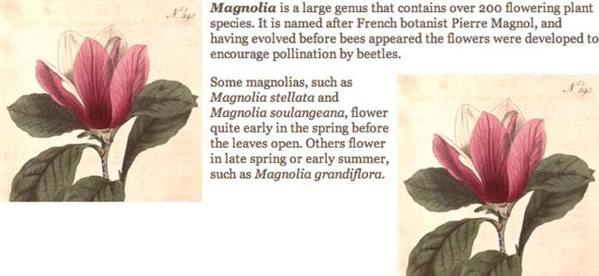

Slide 19
CENTERING IMAGES
USING CSS
img.align-center {
display: block;
margin: 0px auto;}
img.medium {
width: 250px;
height: 250px;}

Slide 20
CENTERING IMAGES
USING CSS
img.align-center {
display: block;
margin: 0px auto;}
img.medium {
width: 250px;
height: 250px;}
Notes:
Display property needs to be added here to center the image.

Slide 21
CENTERING IMAGES
USING CSS
img.align-center {
display: block;
margin: 0px auto;}
img.medium {
width: 250px;
height: 250px;}
Notes:
Margin property needs to be auto for left and right margins.

Slide 22
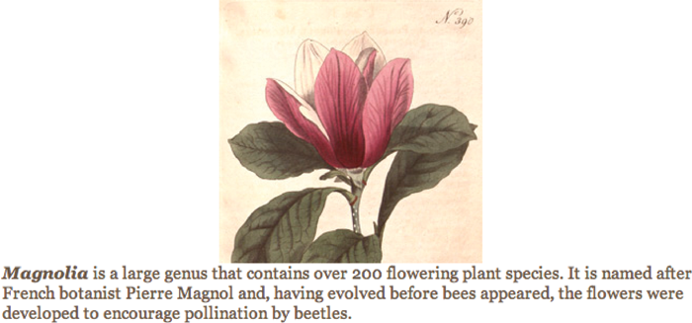

Slide 23
BACKGROUND IMAGES
background-image
p {
background-image: url("images/
pattern.gif");}

Slide 24
BACKGROUND IMAGES
background-image
p {
background-image: url("images/
pattern.gif");}

Slide 25
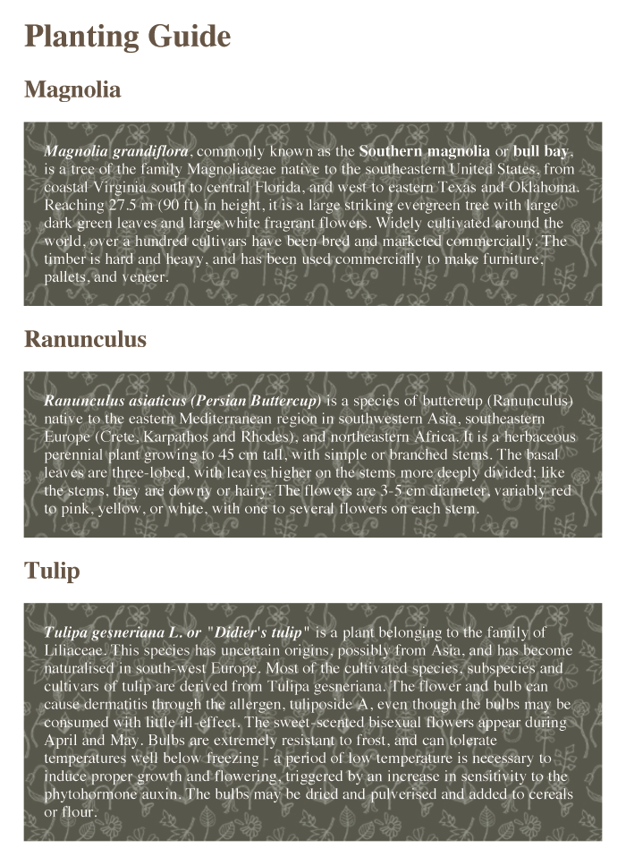

Slide 26
REPEATING IMAGES
background-repeat
body {
background-image: url("images/
header.gif");
background-repeat: repeat-x;}
Notes:
Possible values: repeat-x; repeat-y; no-repeat;

Slide 27
REPEATING IMAGES
background-repeat
body {
background-image: url("images/
header.gif");
background-repeat: repeat-x;}
Notes:
Possible values: repeat-x; repeat-y; no-repeat;

Slide 28
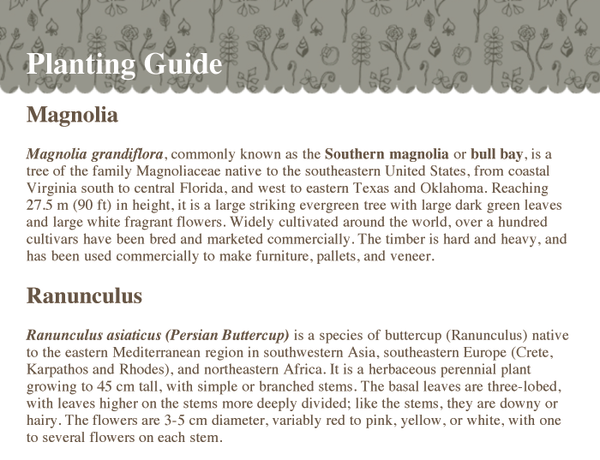

Slide 29
FIXED BACKGROUND IMAGES
background-attachment
body {
background-image: url("images/
tulip.gif");
background-repeat: no-repeat;
background-attachment: fixed;}
Notes:
Possible values: fixed, scroll

Slide 30
FIXED BACKGROUND IMAGES
background-attachment
body {
background-image: url("images/
tulip.gif");
background-repeat: no-repeat;
background-attachment: fixed;}
Notes:
Possible values: fixed, scroll

Slide 31
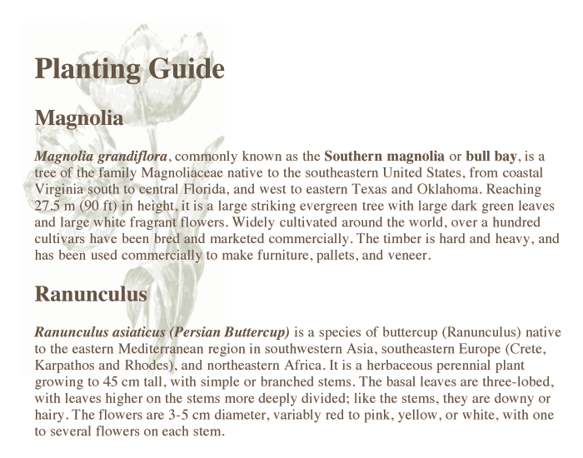

Slide 32
BACKGROUND POSITION
background-position
body {
background-image: url("images/
tulip.gif");
background-repeat: no-repeat;
background-position: center top;}
body {
background-image: url("images/
tulip.gif");
background-repeat: no-repeat;
background-position: 50% 50%;}

Slide 33
BACKGROUND POSITION
background-position
body {
background-image: url("images/
tulip.gif");
background-repeat: no-repeat;
background-position: center top;}
body {
background-image: url("images/
tulip.gif");
background-repeat: no-repeat;
background-position: 50% 50%;}

Slide 34
BACKGROUND POSITION
background-position
body {
background-image: url("images/
tulip.gif");
background-repeat: no-repeat;
background-position: center top;}
body {
background-image: url("images/
tulip.gif");
background-repeat: no-repeat;
background-position: 50% 50%;}

Slide 35
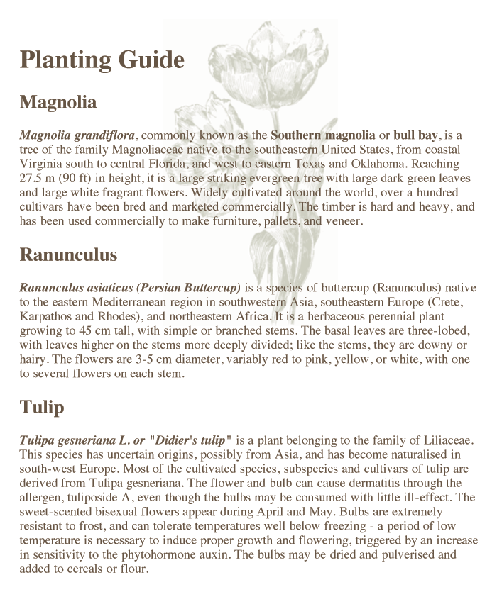

Slide 36
SHORTHAND
background
body {
background: #ffffff url("images/
tulip.gif") no-repeat top right;}
Notes:
Need to specify in following order (but any can be missed)
1: background-color2: background-image3: background-repeatNOTE: background-attachment would be next (not used here)
5: background-position

Slide 37
SHORTHAND
background
body {
background: #ffffff url("images/
tulip.gif") no-repeat top right;}
Notes:
Need to specify in following order (but any can be missed)
1: background-color2: background-image3: background-repeatNOTE: background-attachment would be next (not used here)
5: background-position

Slide 38
SHORTHAND
background
body {
background: #ffffff url("images/
tulip.gif") no-repeat top right;}
Notes:
Need to specify in following order (but any can be missed)
1: background-color2: background-image3: background-repeatNOTE: background-attachment would be next (not used here)
5: background-position

Slide 39
SHORTHAND
background
body {
background: #ffffff url("images/
tulip.gif") no-repeat top right;}
Notes:
Need to specify in following order (but any can be missed)
1: background-color2: background-image3: background-repeatNOTE: background-attachment would be next (not used here)
5: background-position

Slide 40
SHORTHAND
background
body {
background: #ffffff url("images/
tulip.gif") no-repeat top right;}
Notes:
Need to specify in following order (but any can be missed)
1: background-color2: background-image3: background-repeatNOTE: background-attachment would be next (not used here)
5: background-position

Slide 41
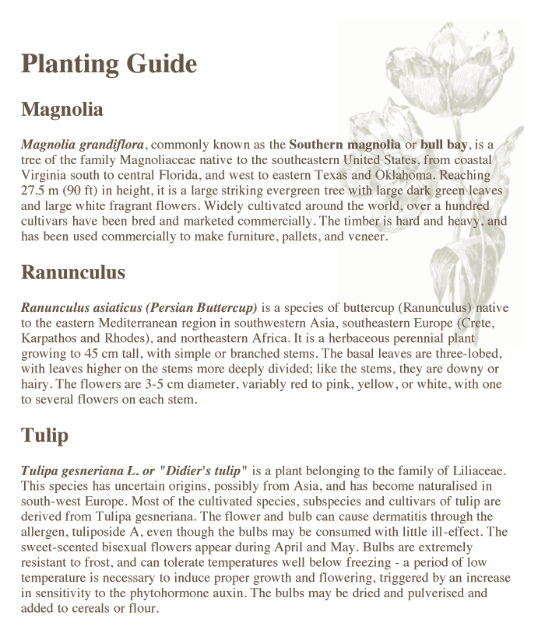

Slide 42

IMAGE ROLLOVERS
& SPRITES
Notes:
Explain: Single image reduces number of calls to server = faster loading

Slide 43
IMAGE ROLLOVERS
& SPRITES
a.button {
height: 36px;
background-image: url("images/button-
sprite.jpg");
text-indent: -9999px;
display: inline-block;}
a#add-to-basket {
width: 174px;
background-position: 0px 0px;}
a#framing-options {
width: 210px;
background-position: -175px 0px;}

Slide 44
IMAGE ROLLOVERS
& SPRITES
a.button {
height: 36px;
background-image: url("images/button-
sprite.jpg");
text-indent: -9999px;
display: inline-block;}
a#add-to-basket {
width: 174px;
background-position: 0px 0px;}
a#framing-options {
width: 210px;
background-position: -175px 0px;}
Notes:
The same background image is used for all links with a class of "button".

Slide 45
IMAGE ROLLOVERS
& SPRITES
a.button {
height: 36px;
background-image: url("images/button-
sprite.jpg");
text-indent: -9999px;
display: inline-block;}
a#add-to-basket {
width: 174px;
background-position: 0px 0px;}
a#framing-options {
width: 210px;
background-position: -175px 0px;}
Notes:
This code allows the dimensions to work.

Slide 46
IMAGE ROLLOVERS
& SPRITES
a.button {
height: 36px;
background-image: url("images/button-
sprite.jpg");
text-indent: -9999px;
display: inline-block;}
a#add-to-basket {
width: 174px;
background-position: 0px 0px;}
a#framing-options {
width: 210px;
background-position: -175px 0px;}
Notes:
Here you can see they display different parts of the image.

Slide 47
IMAGE ROLLOVERS
& SPRITES
a.button {
height: 36px;
background-image: url("images/button-
sprite.jpg");
text-indent: -9999px;
display: inline-block;}
a#add-to-basket {
width: 174px;
background-position: 0px 0px;}
a#framing-options {
width: 210px;
background-position: -175px 0px;}
Notes:
All buttons are the same height.

Slide 48
IMAGE ROLLOVERS
& SPRITES
a.button {
height: 36px;
background-image: url("images/button-
sprite.jpg");
text-indent: -9999px;
display: inline-block;}
a#add-to-basket {
width: 174px;
background-position: 0px 0px;}
a#framing-options {
width: 210px;
background-position: -175px 0px;}
Notes:
The width property for specific links varies for each button.

Slide 49
IMAGE ROLLOVERS
& SPRITES
a#add-to-basket:hover {
background-position: 0px -40px;}
a#framing-options:hover {
background-position: -175px -40px;}
a#add-to-basket:active {
background-position: 0px -80px;}
a#framing-options:active {
background-position: -175px -80px;}

Slide 50
IMAGE ROLLOVERS
& SPRITES
a#add-to-basket:hover {
background-position: 0px -40px;}
a#framing-options:hover {
background-position: -175px -40px;}
a#add-to-basket:active {
background-position: 0px -80px;}
a#framing-options:active {
background-position: -175px -80px;}
Notes:
Hover states move the background position on mouseover.

Slide 51
IMAGE ROLLOVERS
& SPRITES
a#add-to-basket:hover {
background-position: 0px -40px;}
a#framing-options:hover {
background-position: -175px -40px;}
a#add-to-basket:active {
background-position: 0px -80px;}
a#framing-options:active {
background-position: -175px -80px;}
Notes:
Active states move the background position to show clicking.

Slide 52


Slide 53
CSS3: GRADIENTS
background-image
#gradient {
/* fallback color */
background-color: #66cccc;
/* fallback image */
background-image:url("images/fallback
-image.png");
/* Firefox 3.6+ */
background-image:
-moz-linear-gradient(#336666, #66cccc);
Notes:
CSS3 gradients do not work with all browsers.

Slide 54
CSS3: GRADIENTS
background-image
#gradient {
/* fallback color */
background-color: #66cccc;
/* fallback image */
background-image:url("images/fallback
-image.png");
/* Firefox 3.6+ */
background-image:
-moz-linear-gradient(#336666, #66cccc);
Notes:
This is the color that will appear if the browser does not support CSS3 gradients.

Slide 55
CSS3: GRADIENTS
background-image
#gradient {
/* fallback color */
background-color: #66cccc;
/* fallback image */
background-image:url("images/fallback
-image.png");
/* Firefox 3.6+ */
background-image:
-moz-linear-gradient(#336666, #66cccc);
Notes:
The fallback image contains its own gradient.

Slide 56
CSS3: GRADIENTS
background-image
#gradient {
/* fallback color */
background-color: #66cccc;
/* fallback image */
background-image:url("images/fallback
-image.png");
/* Firefox 3.6+ */
background-image:
-moz-linear-gradient(#336666, #66cccc);
Notes:
The Firefox syntax includes a "from color" and a "to color" in parentheses.

Slide 57
CSS3: GRADIENTS
background-image
/* Safari 4+, Chrome 1+ */
background-image:
-webkit-gradient(linear, 0% 0%,
0% 100%, from(#66cccc), to(#336666));
/* Safari 5.1+, Chrome 10+ */
background-image:
-webkit-linear-gradient(#336666,#66cccc);
/* Opera 11.10+ */
background-image:
-o-linear-gradient(#336666, #66cccc); }

Slide 58
CSS3: GRADIENTS
background-image
/* Safari 4+, Chrome 1+ */
background-image:
-webkit-gradient(linear, 0% 0%,
0% 100%, from(#66cccc), to(#336666));
/* Safari 5.1+, Chrome 10+ */
background-image:
-webkit-linear-gradient(#336666,#66cccc);
/* Opera 11.10+ */
background-image:
-o-linear-gradient(#336666, #66cccc); }

Slide 59
CSS3: GRADIENTS
background-image
/* Safari 4+, Chrome 1+ */
background-image:
-webkit-gradient(linear, 0% 0%,
0% 100%, from(#66cccc), to(#336666));
/* Safari 5.1+, Chrome 10+ */
background-image:
-webkit-linear-gradient(#336666,#66cccc);
/* Opera 11.10+ */
background-image:
-o-linear-gradient(#336666, #66cccc); }

Slide 60
CSS3: GRADIENTS
background-image
/* Safari 4+, Chrome 1+ */
background-image:
-webkit-gradient(linear, 0% 0%,
0% 100%, from(#66cccc), to(#336666));
/* Safari 5.1+, Chrome 10+ */
background-image:
-webkit-linear-gradient(#336666,#66cccc);
/* Opera 11.10+ */
background-image:
-o-linear-gradient(#336666, #66cccc); }

Slide 61


Slide 62


CONTRAST OF
BACKGROUND IMAGES
HIGH CONTRAST
LOW CONTRAST
SCREEN
unreadable
readable
readable
Notes:
Shows how contrast between images and overlaid text affects readability.

Slide 63
SUMMARY
You can specify the dimensions of images using CSS. This is very helpful when you use the same sized images on several pages of your site.
Notes:
Clicks: Load individual bullets

Slide 64
SUMMARY
Images can be aligned both horizontally and vertically using CSS.
Notes:
Clicks: Load individual bullets

Slide 65
SUMMARY
You can use a background image behind the box created by any element
on a page.
Notes:
Clicks: Load individual bullets

Slide 66
SUMMARY
Background images can appear just once or be repeated across the background of the box.
Notes:
Clicks: Load individual bullets

Slide 67
SUMMARY
You can create image rollover effects by moving the background position of an image.
Notes:
Clicks: Load individual bullets

Slide 68
SUMMARY
To reduce the number of images your browser has
to load, you can create image sprites.
Notes:
Clicks: Load individual bullets

Slide 69
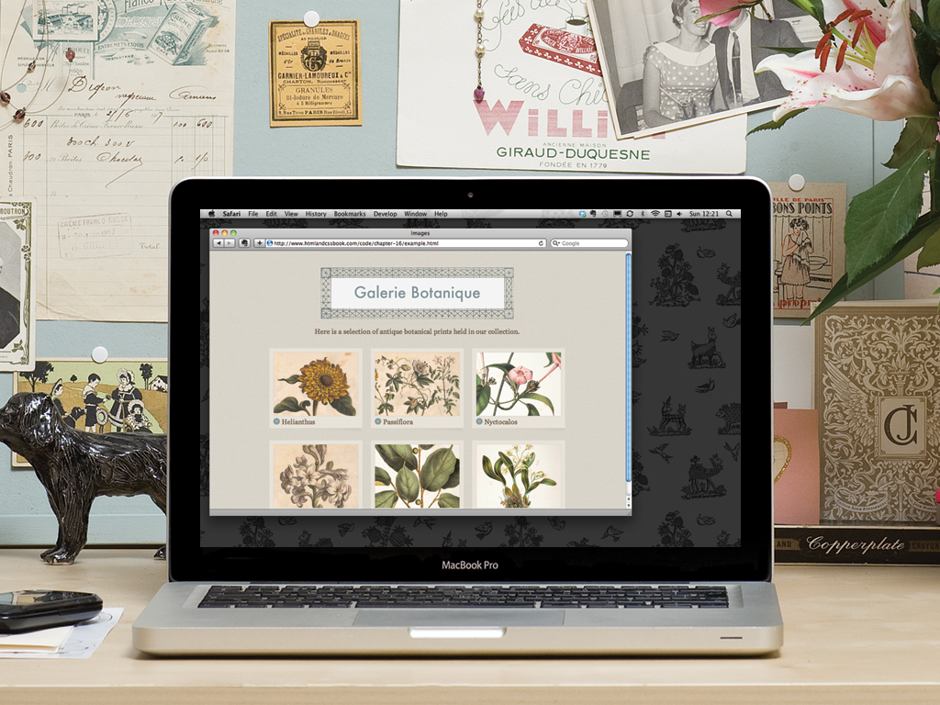

Slide 70


